Slide 1
ANALYSIS AND REPORTING SYSTEM OF BANK ACCOUNT DETAILS
By
SWARNALATHA

Slide 2
Main objective:- -------------------------- Development of a analysis and reporting on back account details

Slide 3
Project flow
EXTRACT
REPORTS
Heterogeneous Sources i.e. operational data (Flat files)
TRANSFORM
Data warehouse (Oracle)
Reports Based On Tool
LOAD

Slide 4
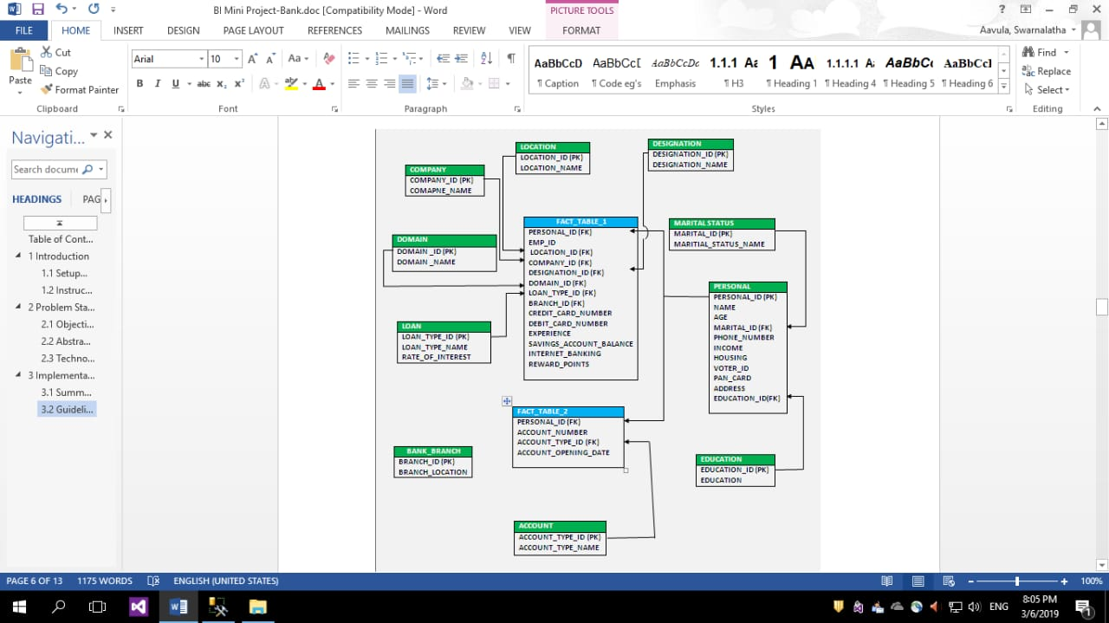
Sample schema(snowflake)

Slide 5
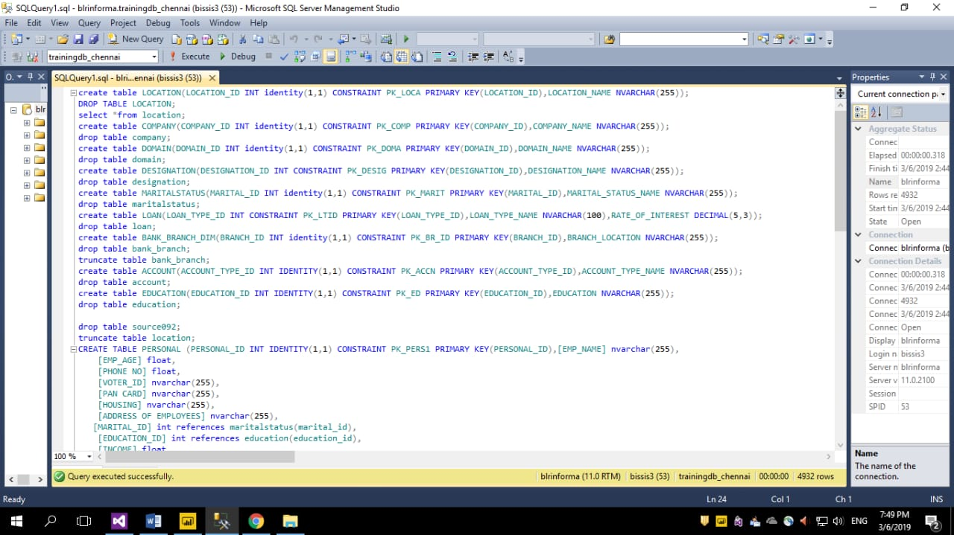
SQL queries to create table

Slide 6
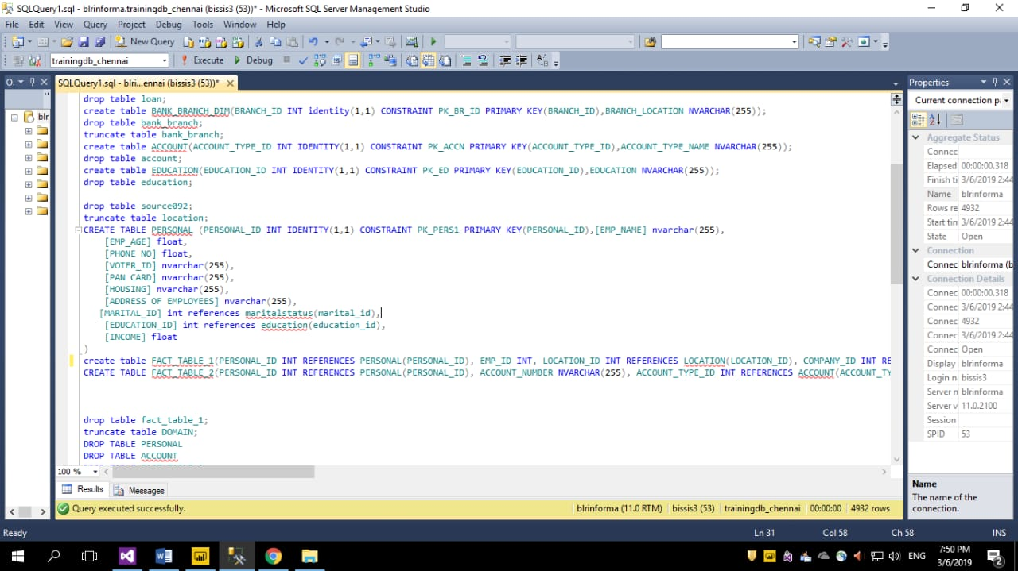

Slide 7
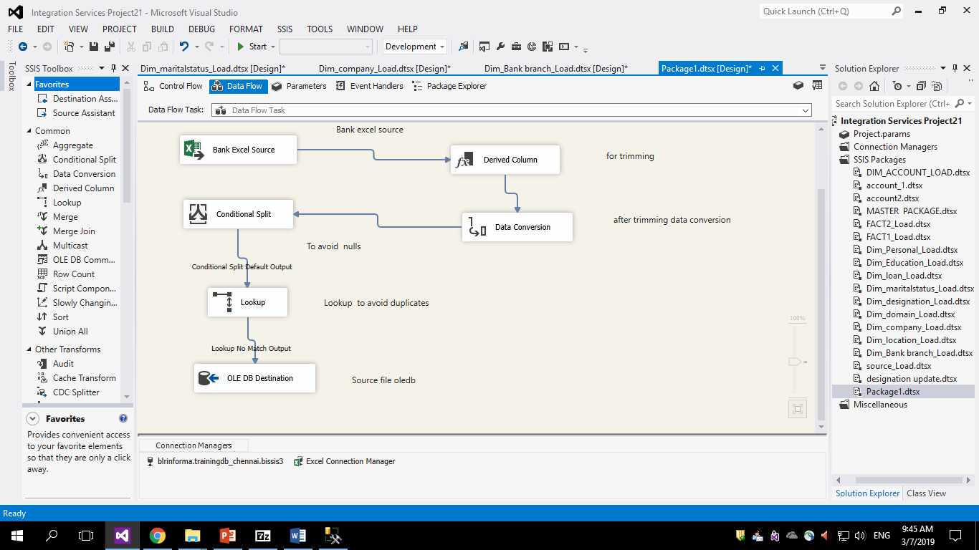
Extraction Transformation and loading

Slide 8
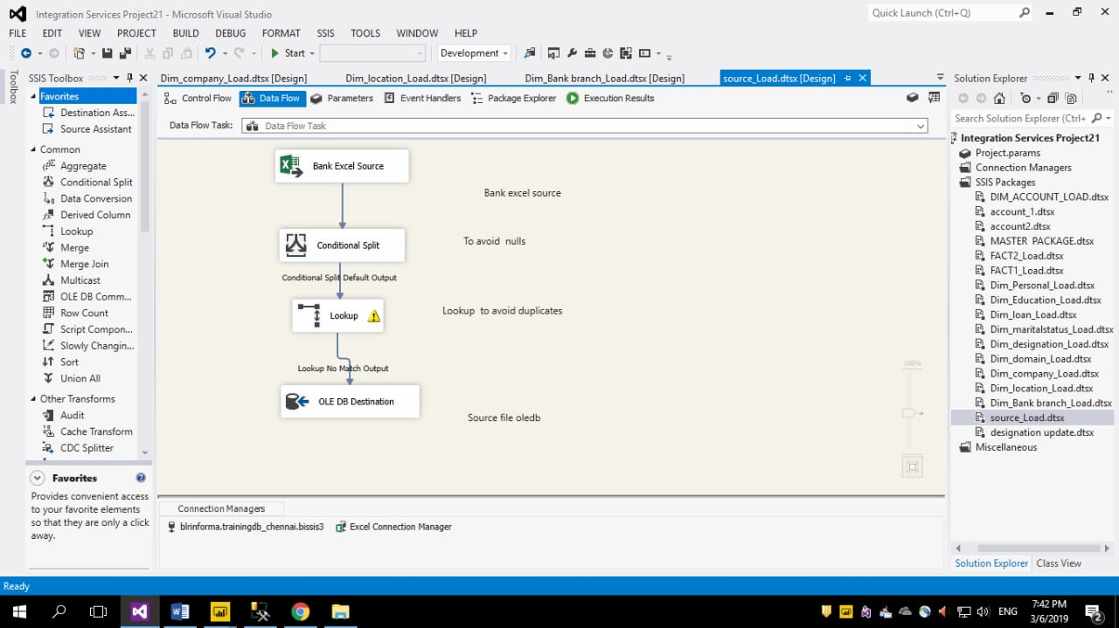
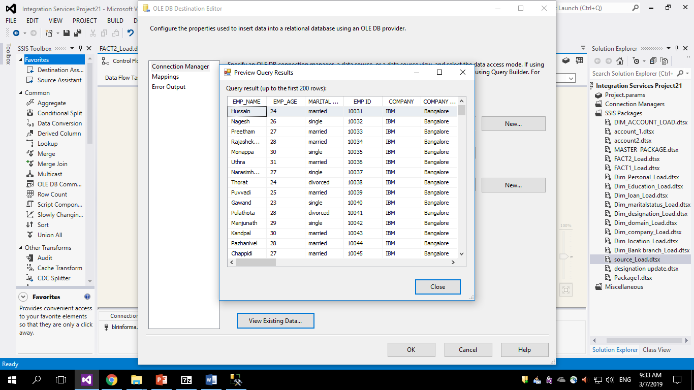
Source load

Slide 9
SQL Server Integration Services
Dimensions
Facts

Slide 10
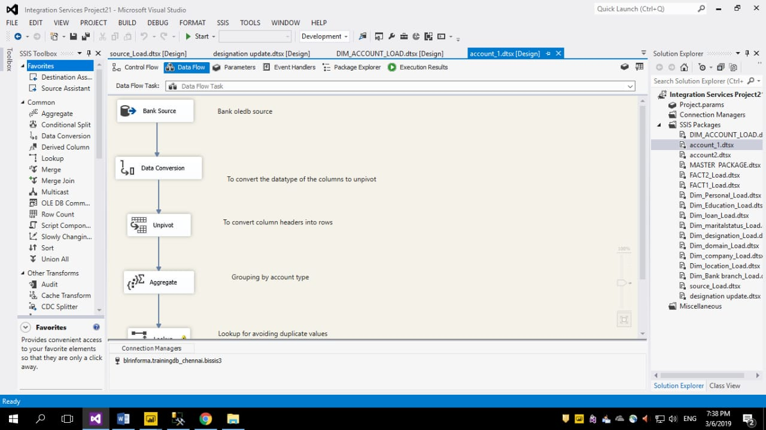
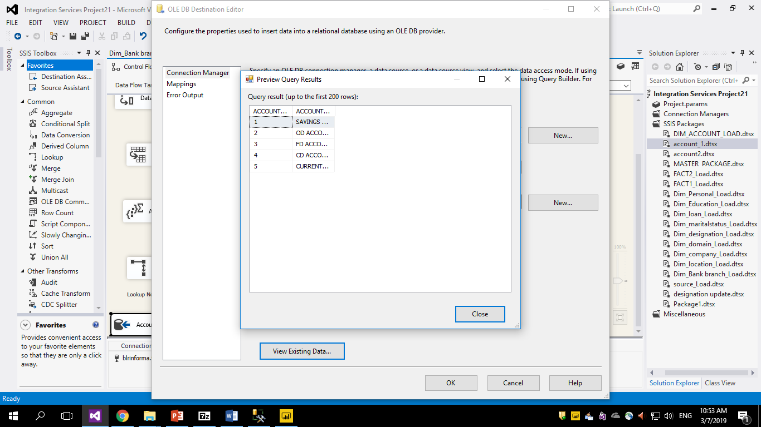

Slide 11
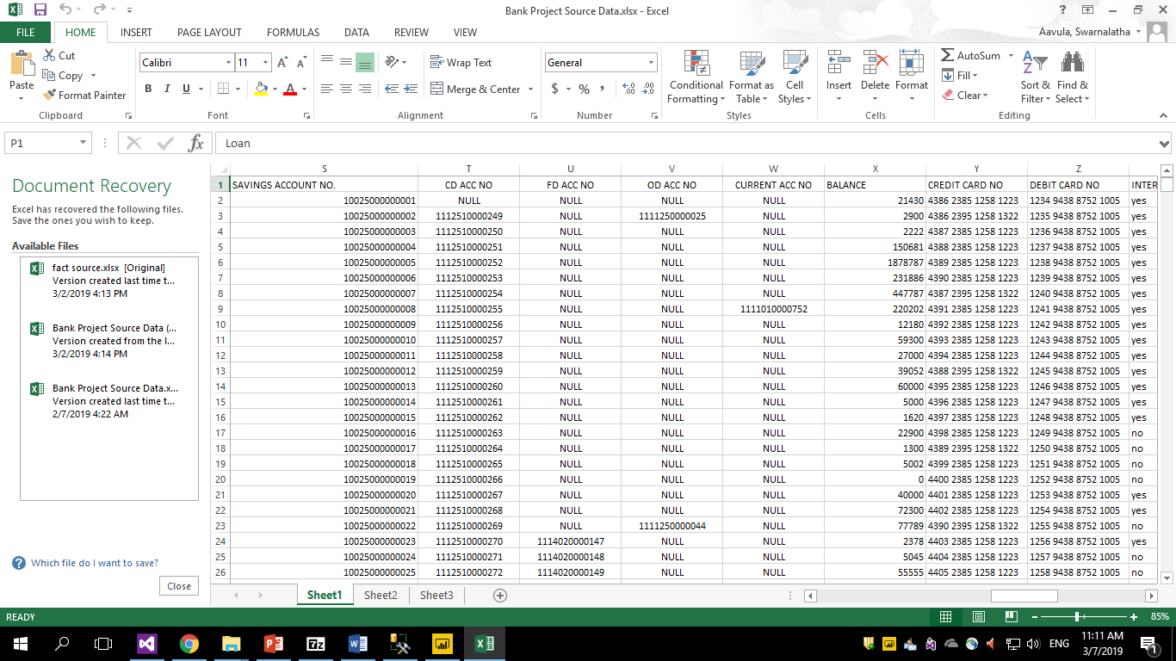
Bank details Excel source

Slide 12
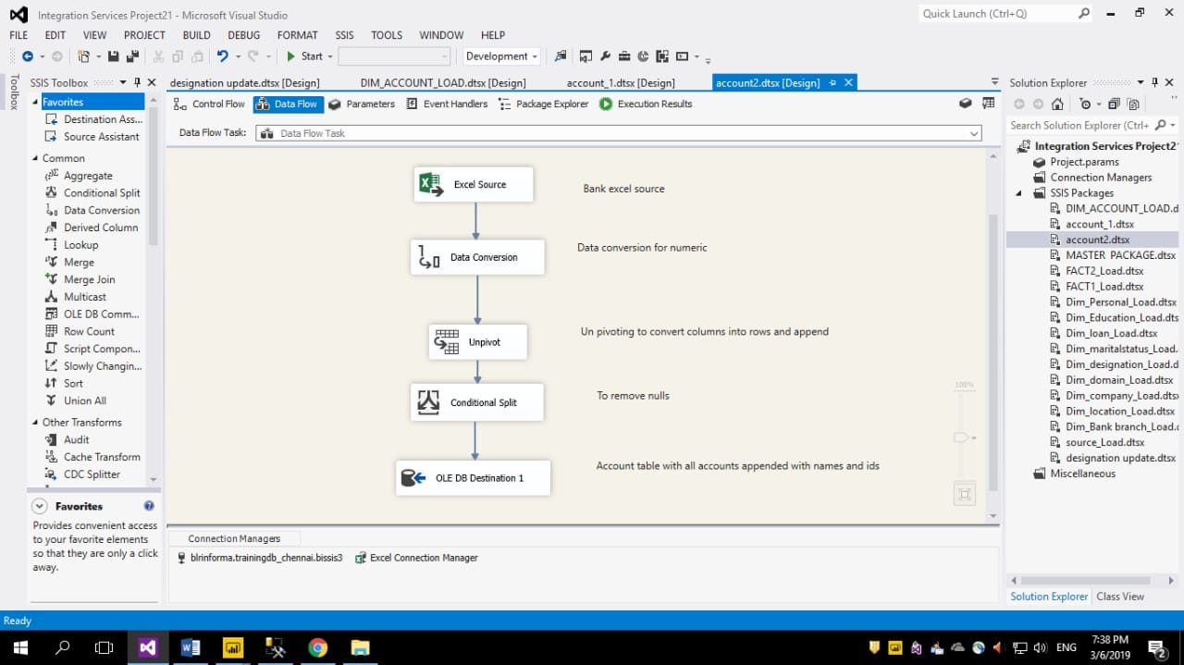
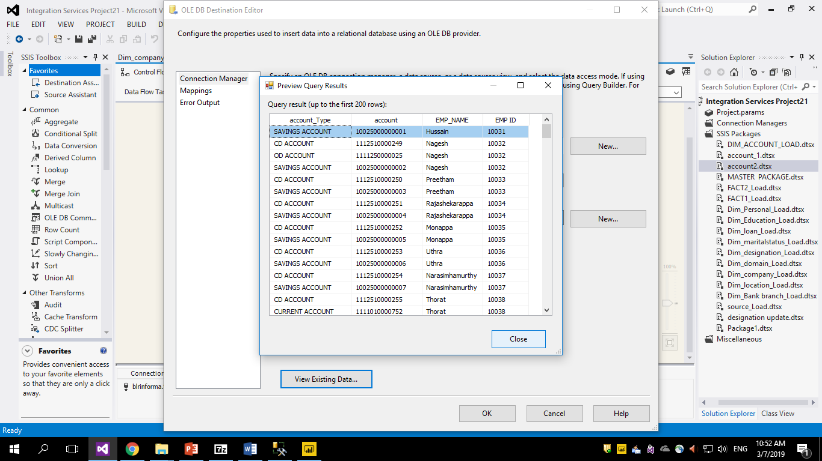

Slide 13
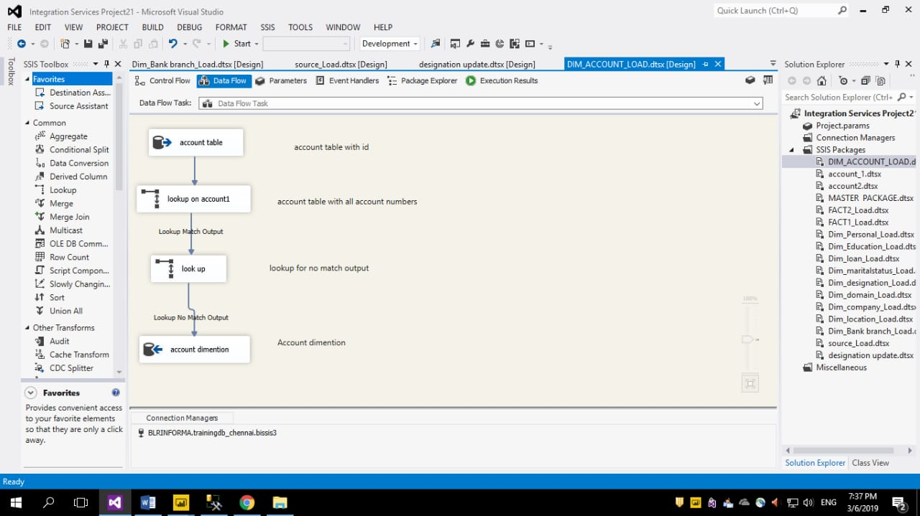
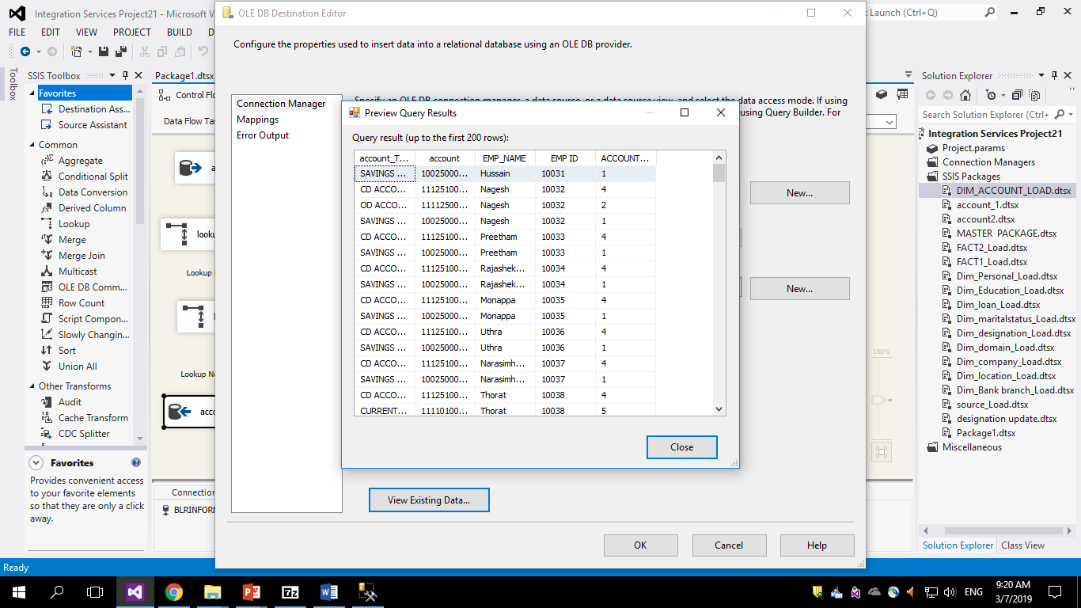
Account dimension table load

Slide 14
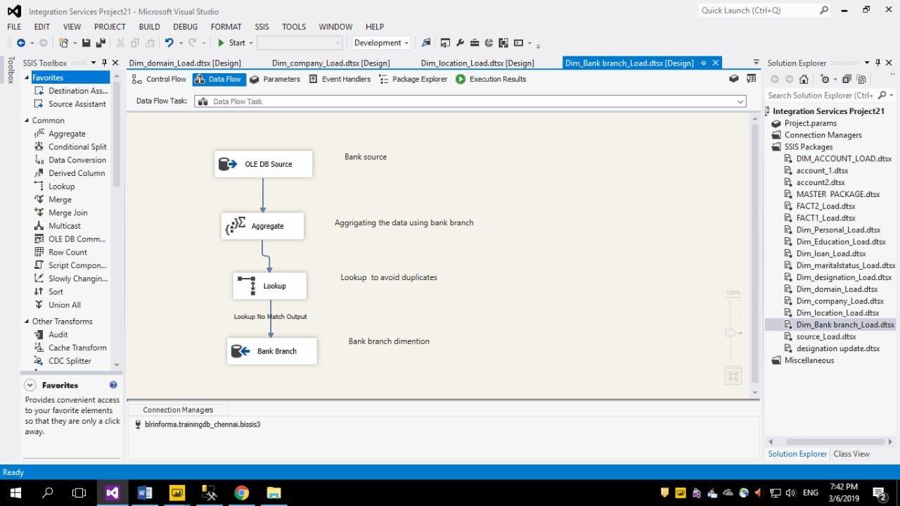
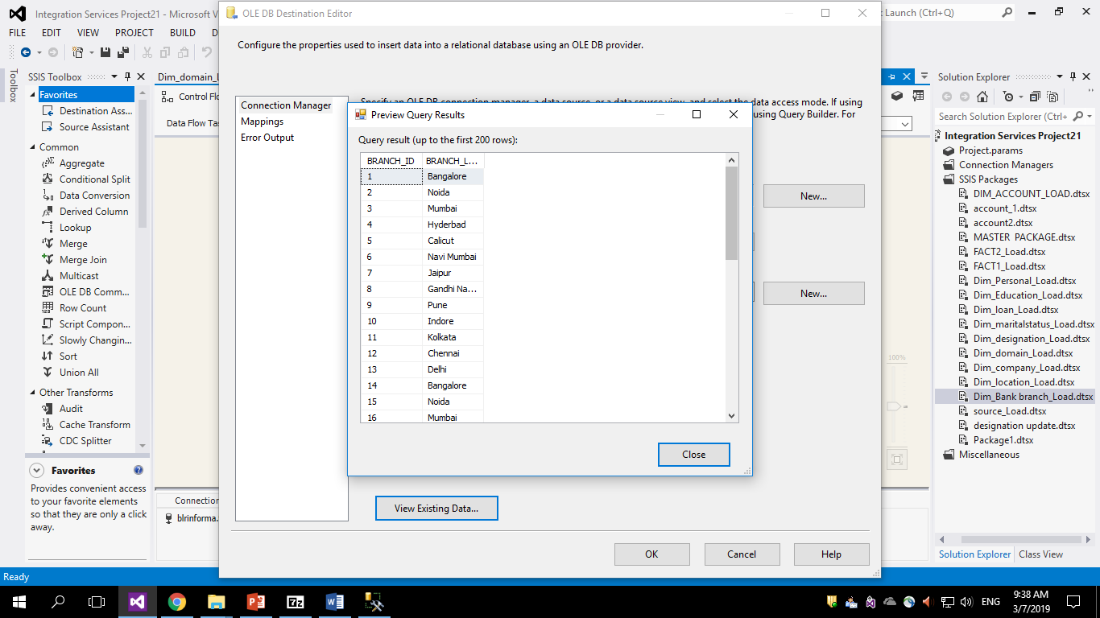
Bank branch dimension load

Slide 15
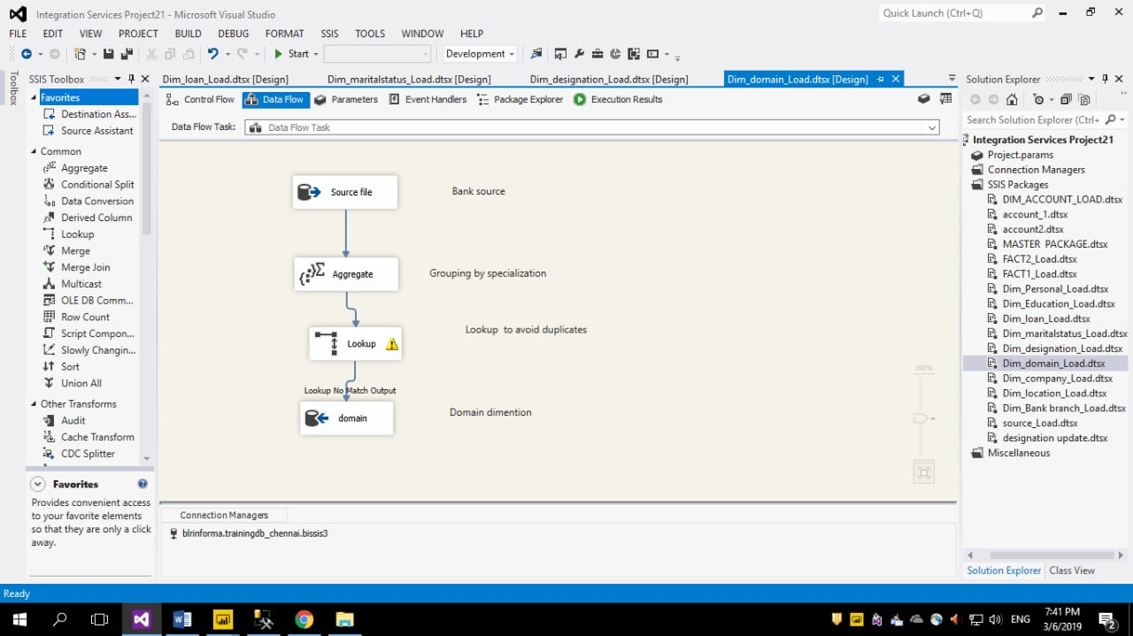
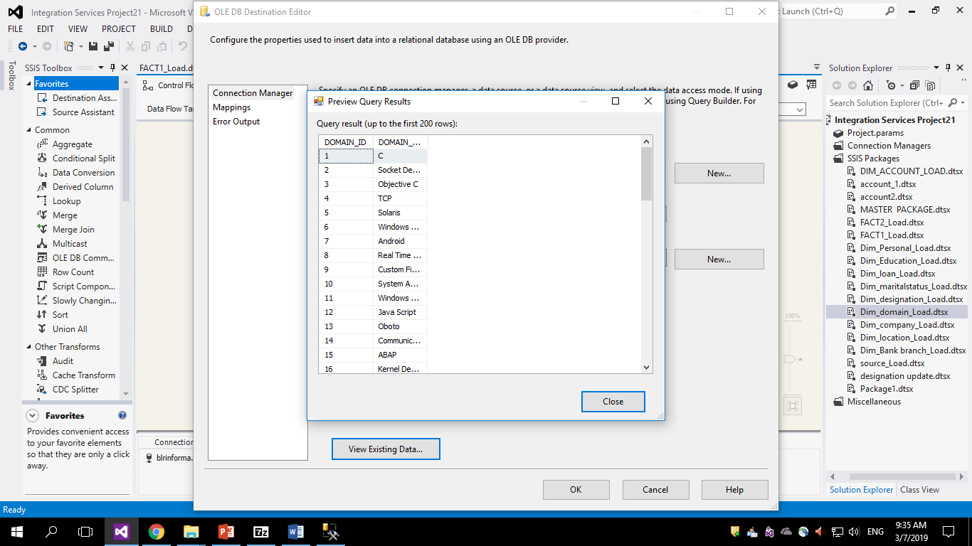
Domain dimension table load

Slide 16
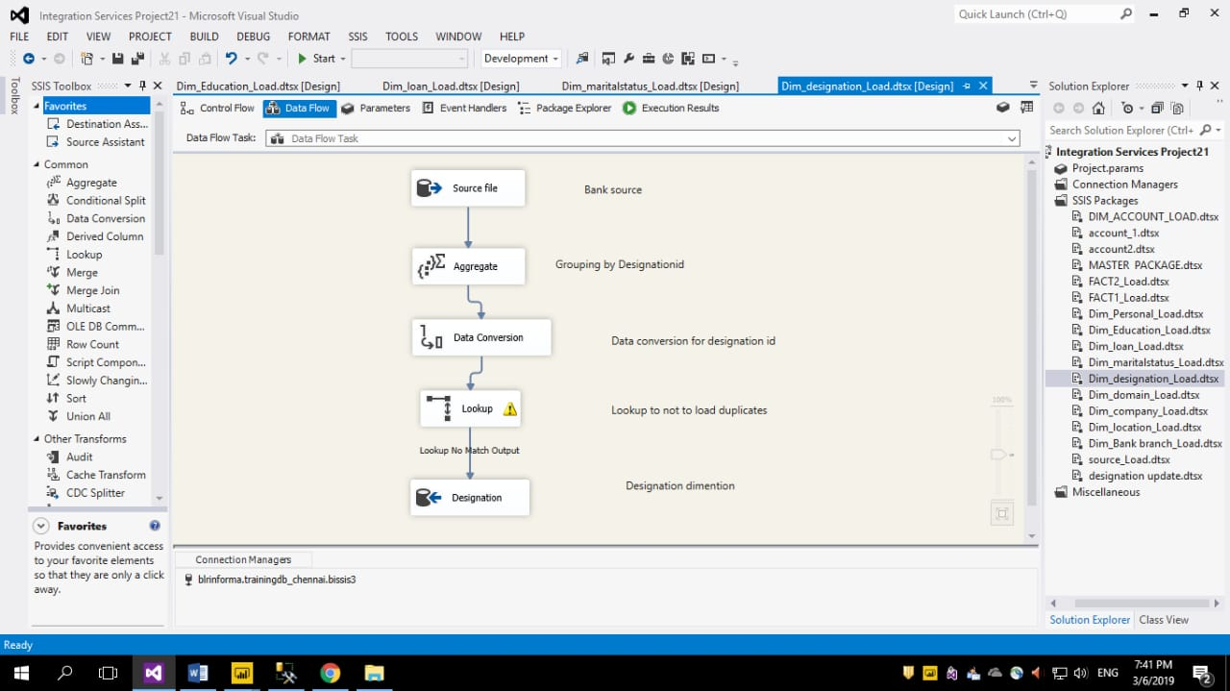
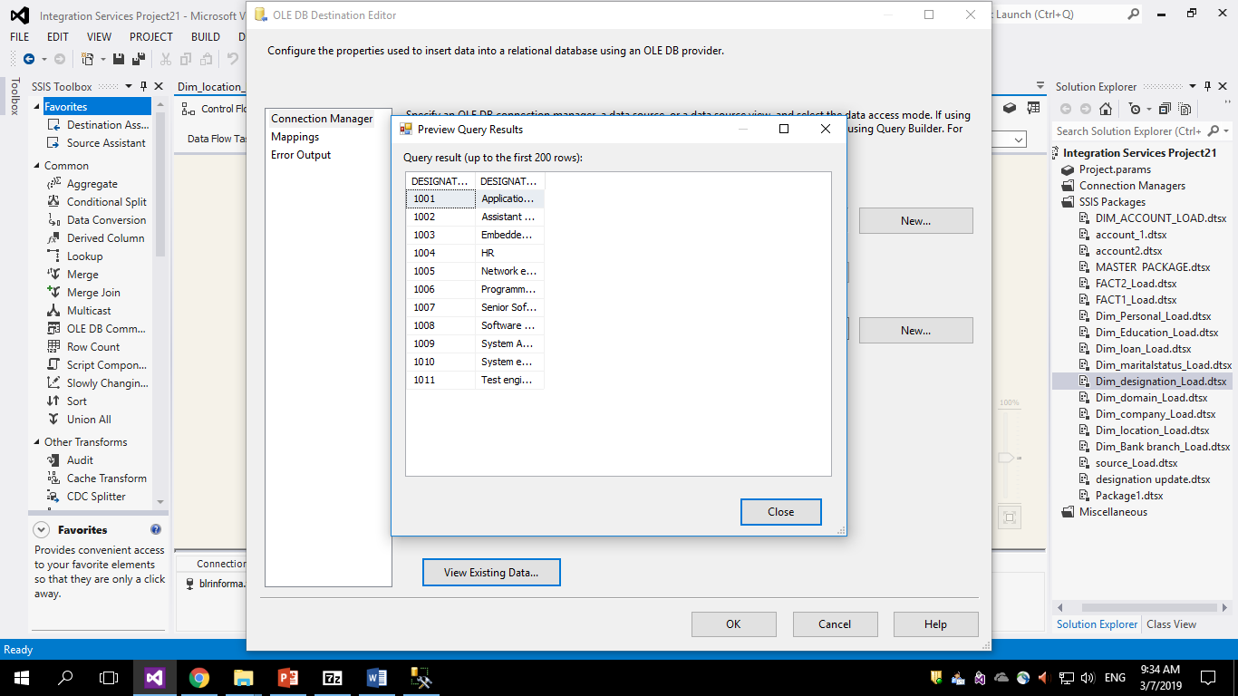
Designation dimension table load

Slide 17
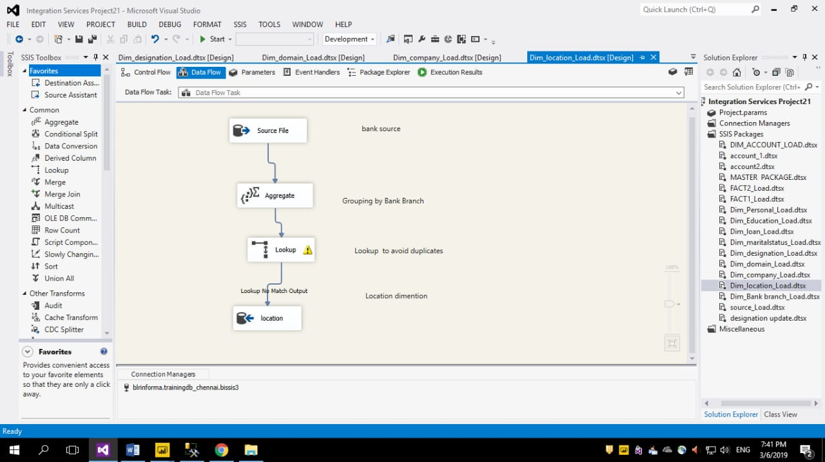
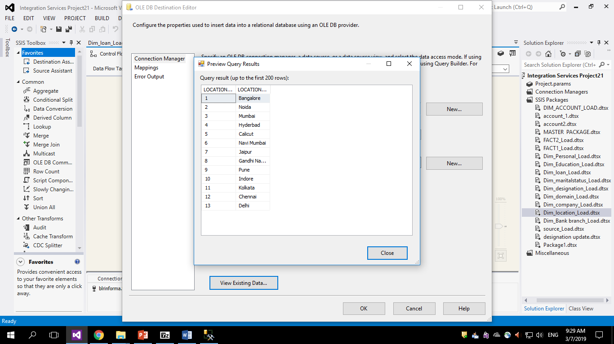
Location dimension table load

Slide 18
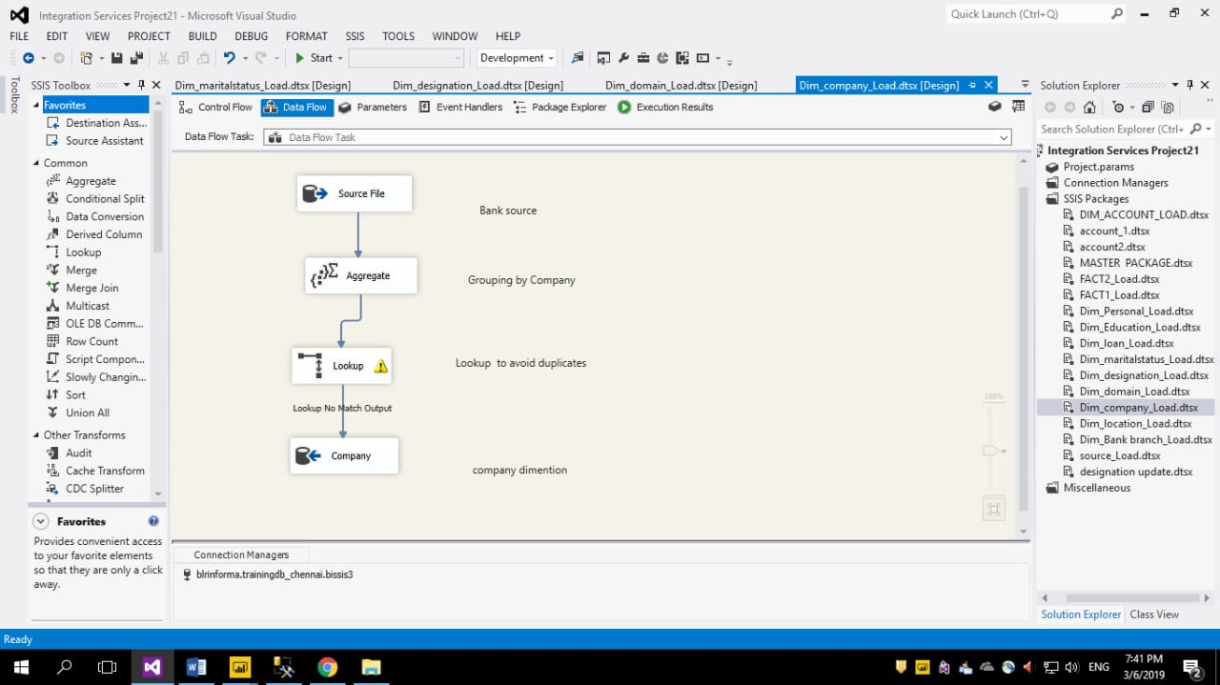
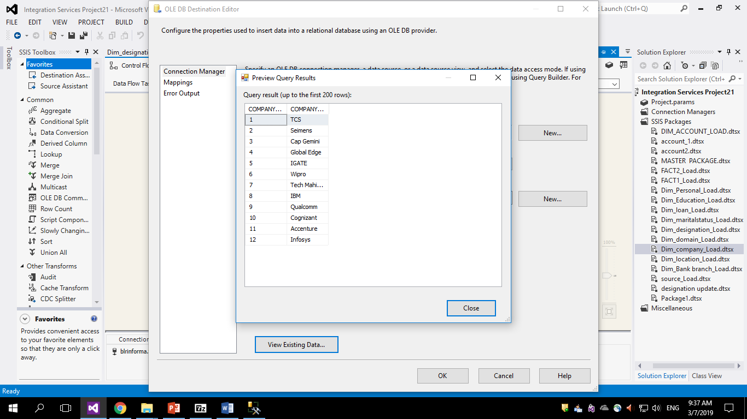
Company dimension table load

Slide 19
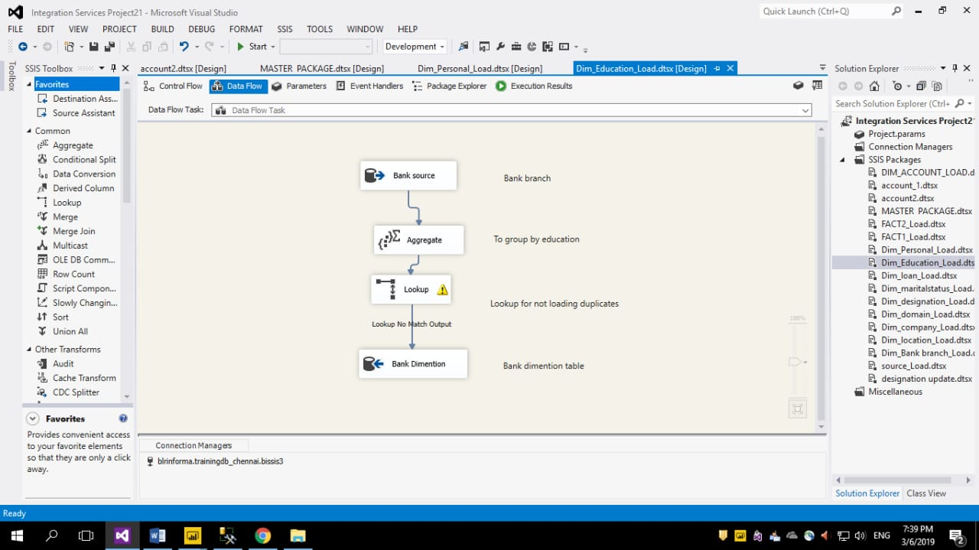
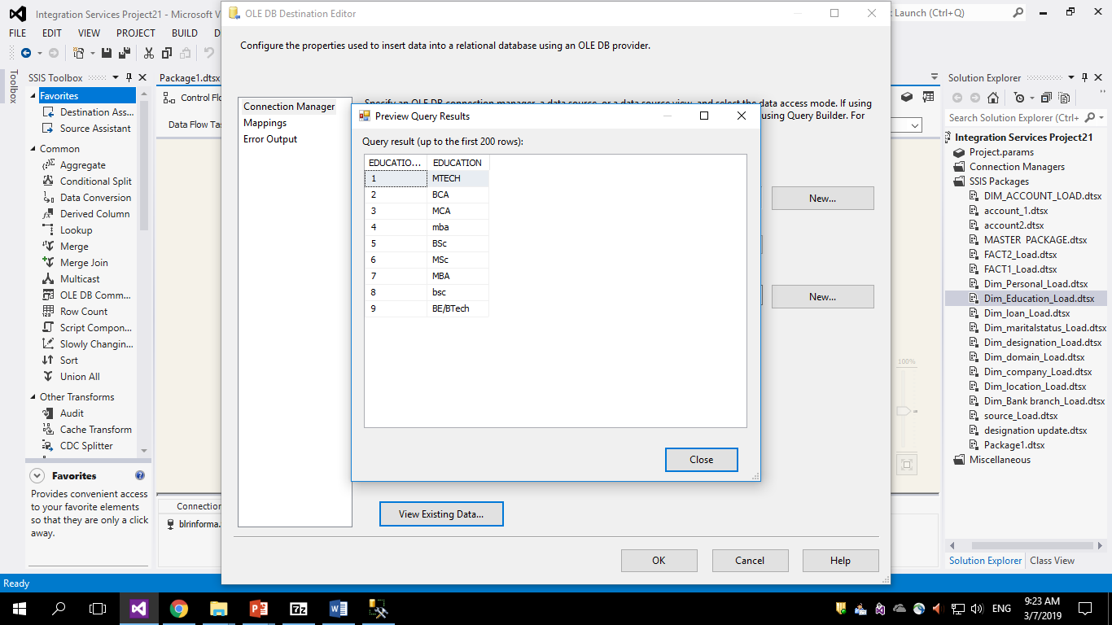
Education dimension table load

Slide 20
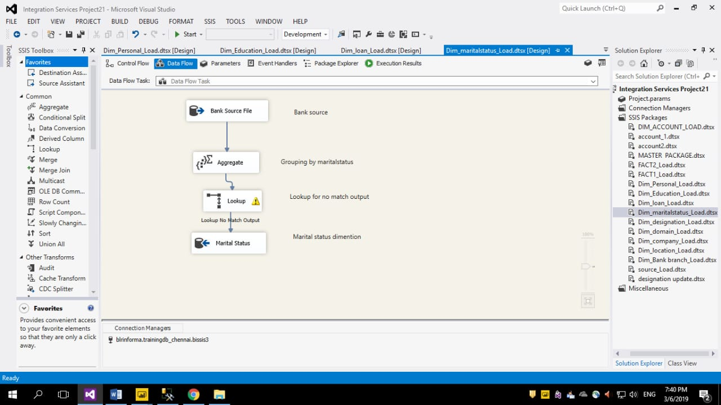
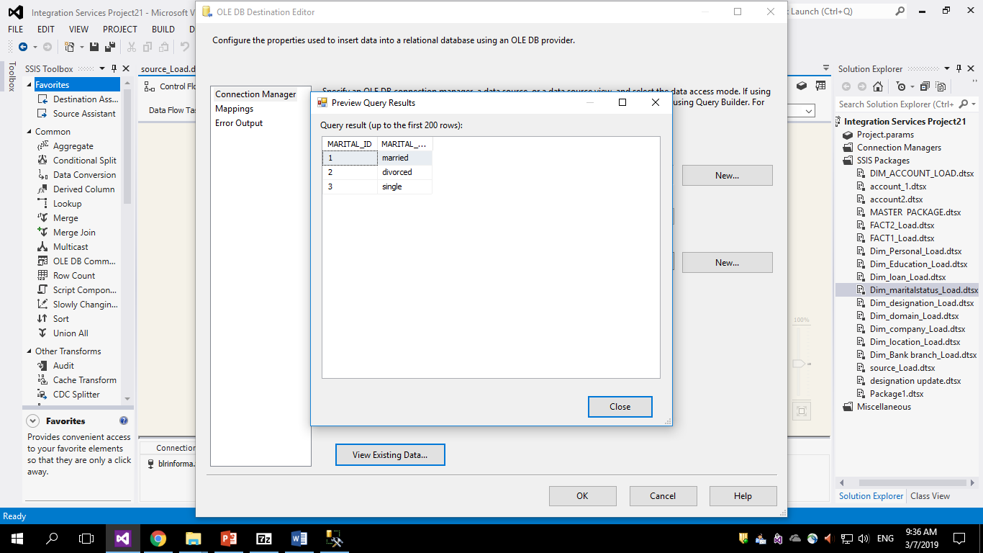
Marital Status dimension table load

Slide 21
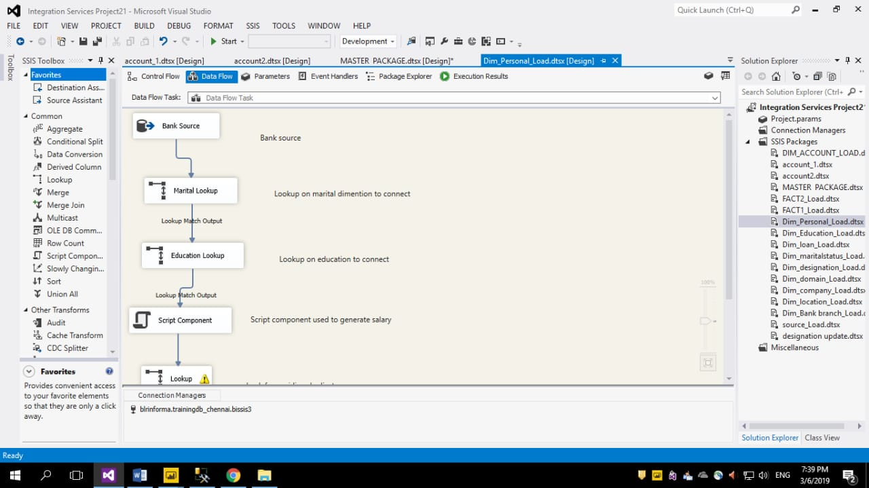
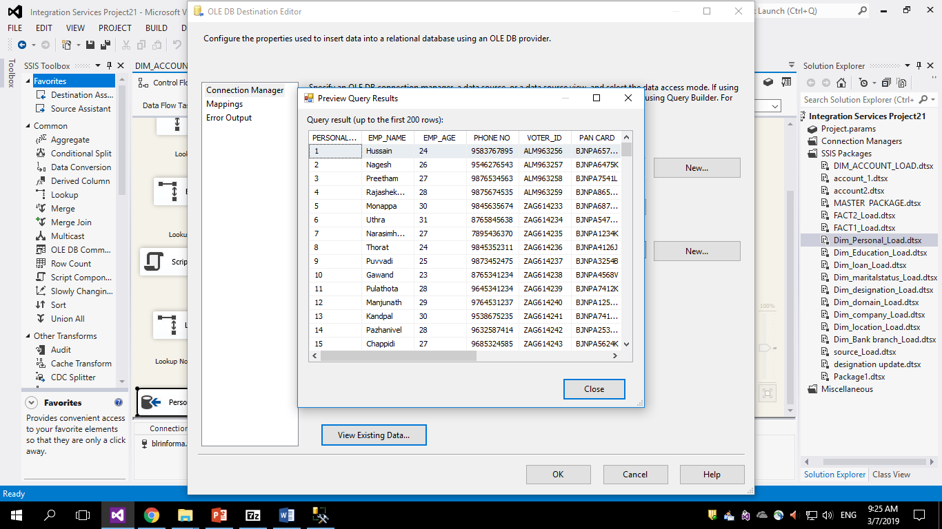
Personal dimension table load

Slide 22
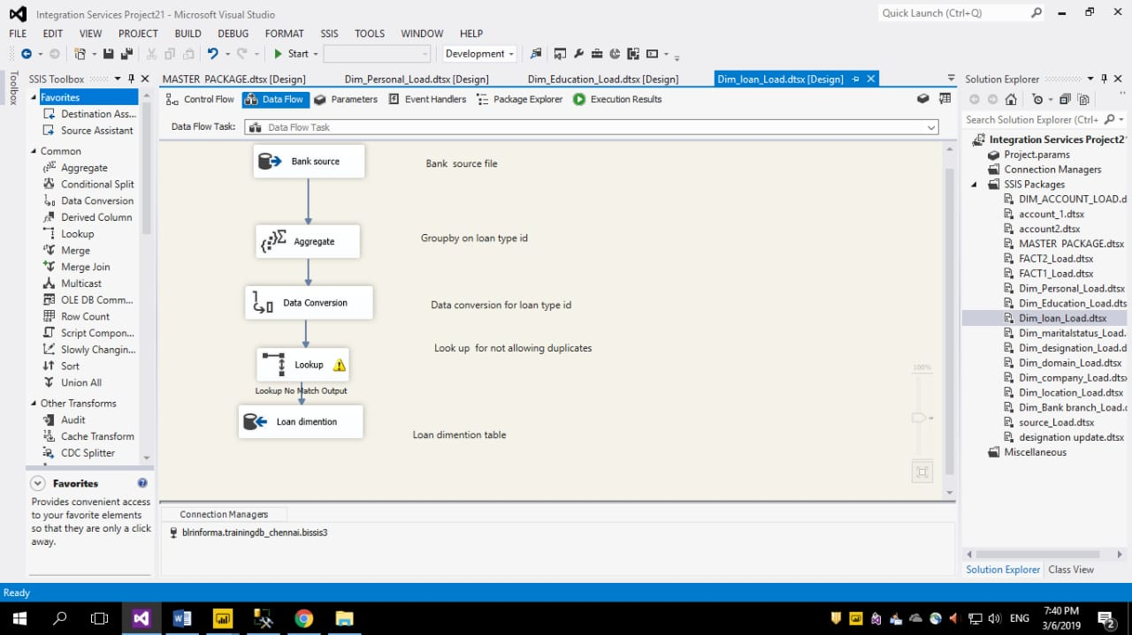
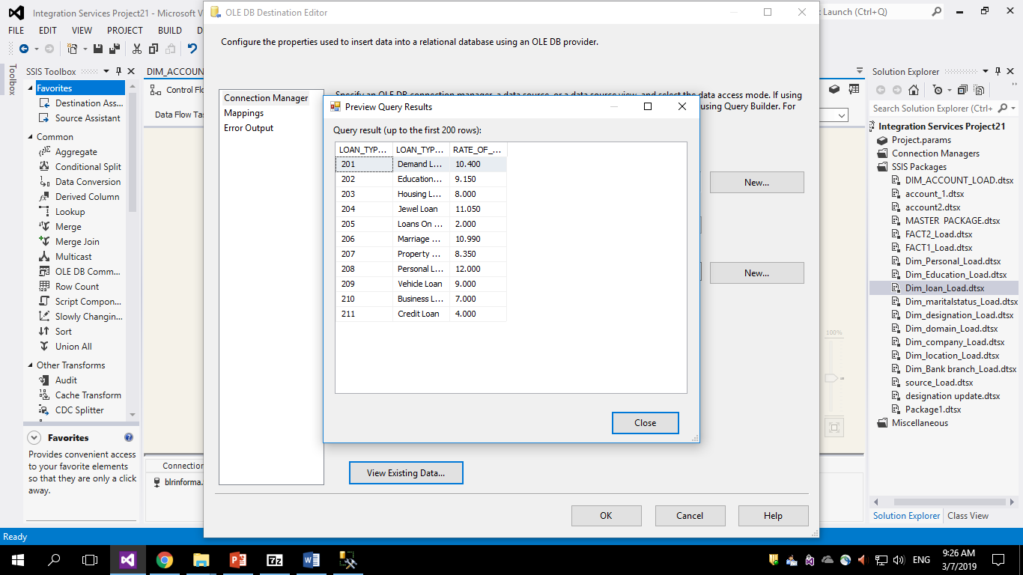
Loan dimension table load

Slide 23
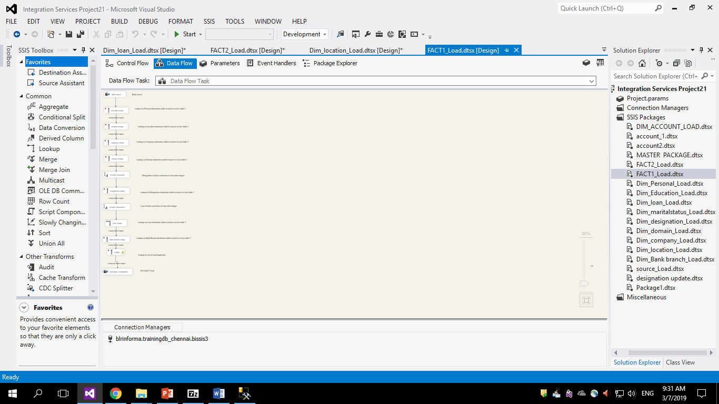
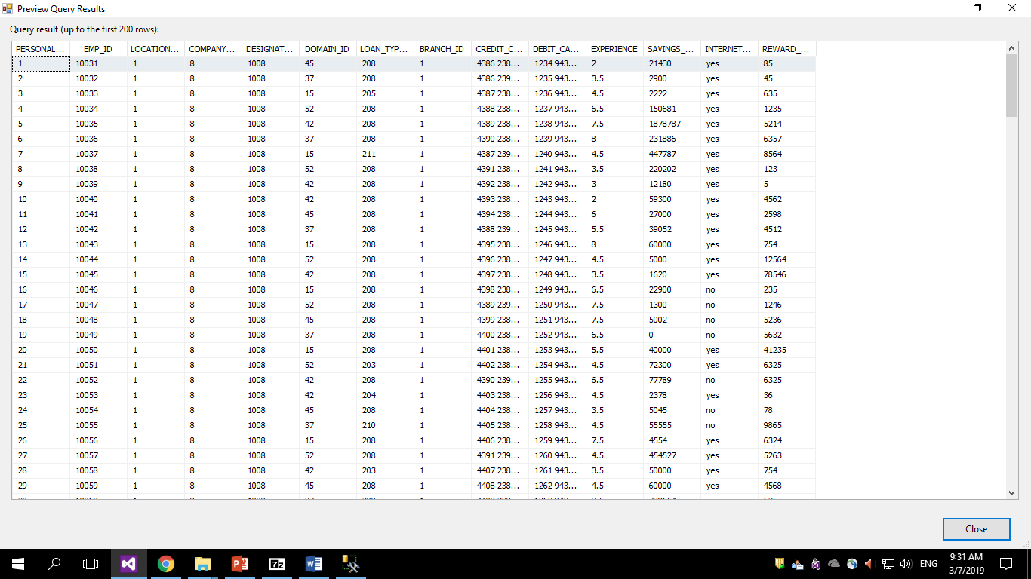
Fact table1 load

Slide 24
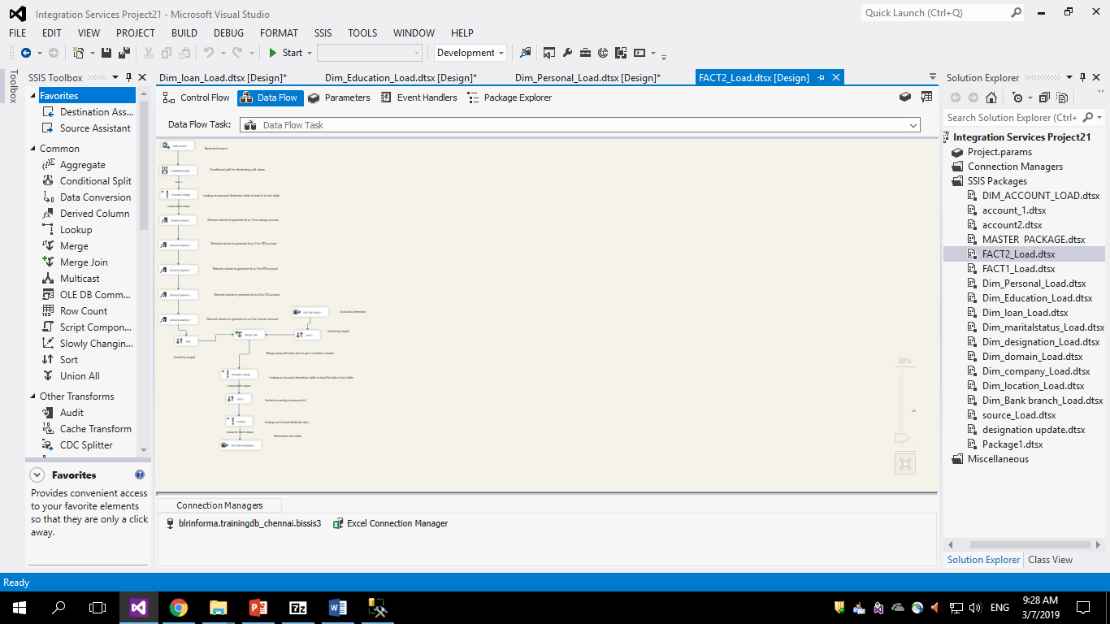
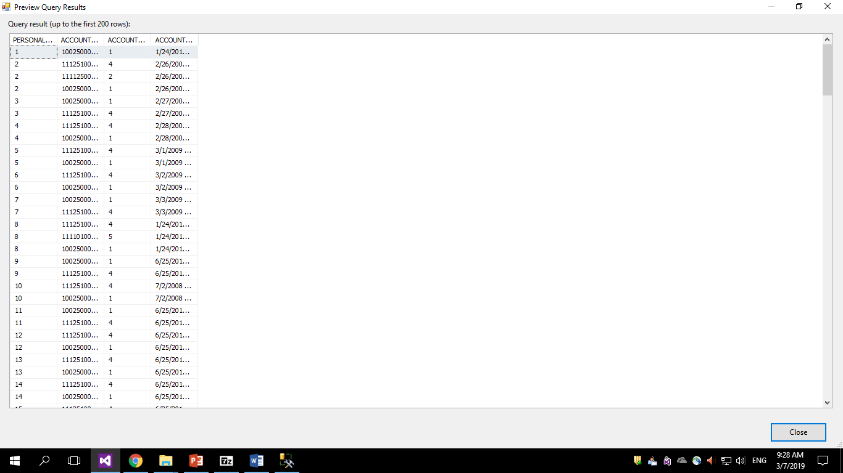
Fact table 2 load

Slide 25
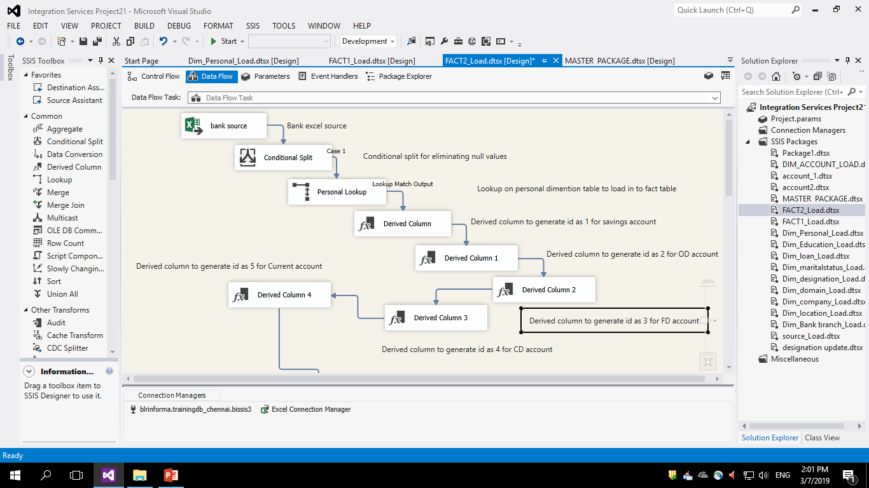

Slide 26
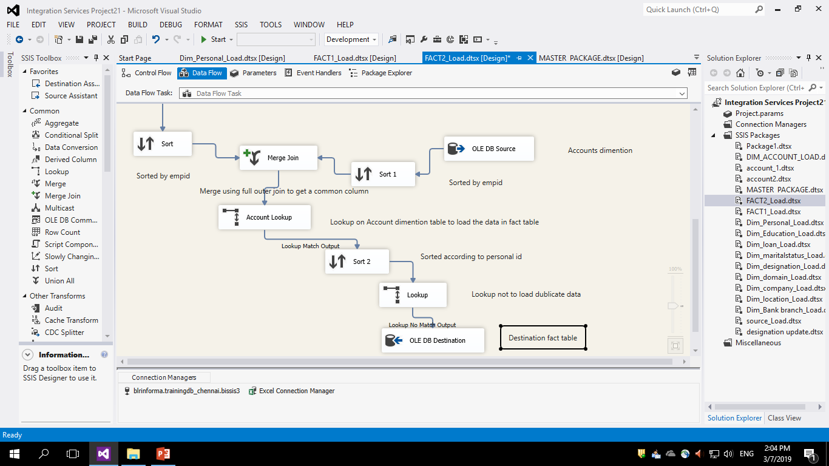

Slide 27
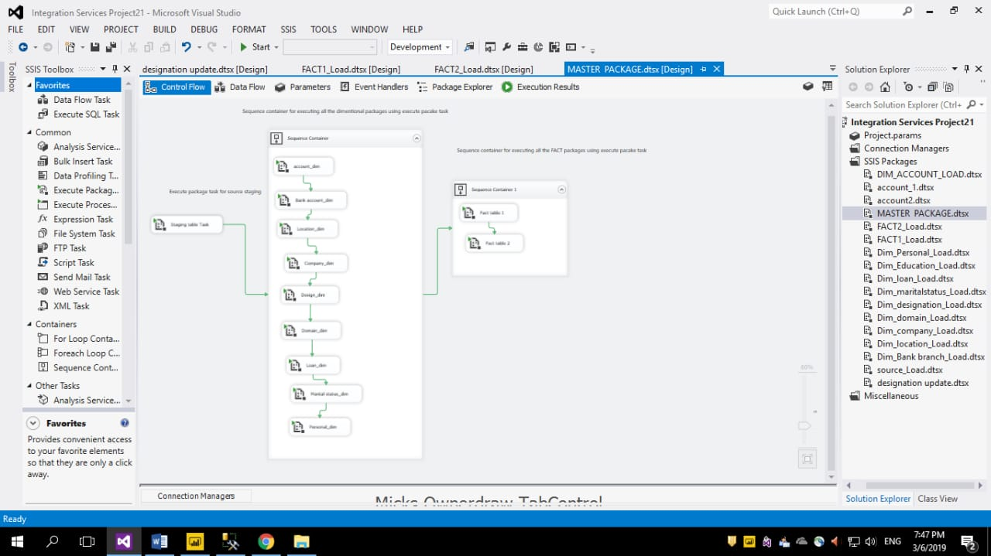
Master package

Slide 28
Reports based on data for easy analysis by using power bi

Slide 29
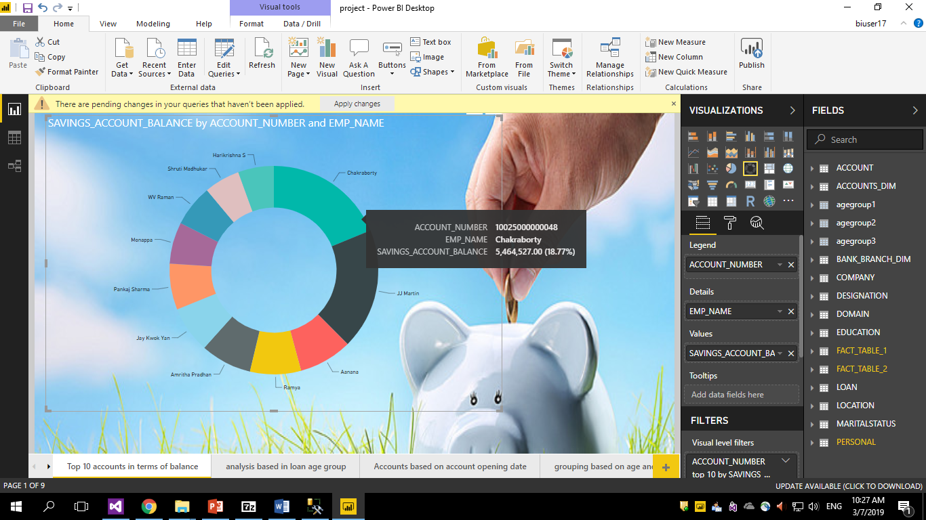
Top 10 accounts in terms of savings account balance

Slide 30
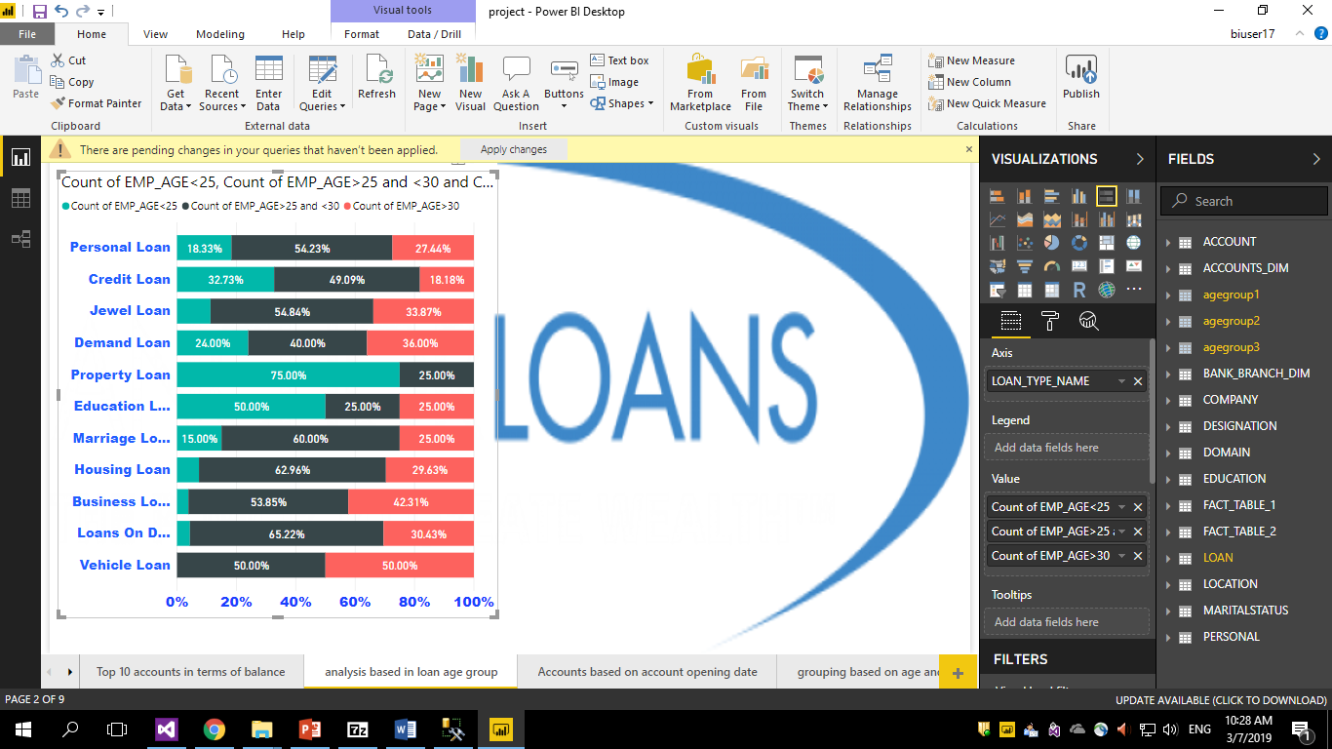
Analysis based on loan and age group

Slide 31
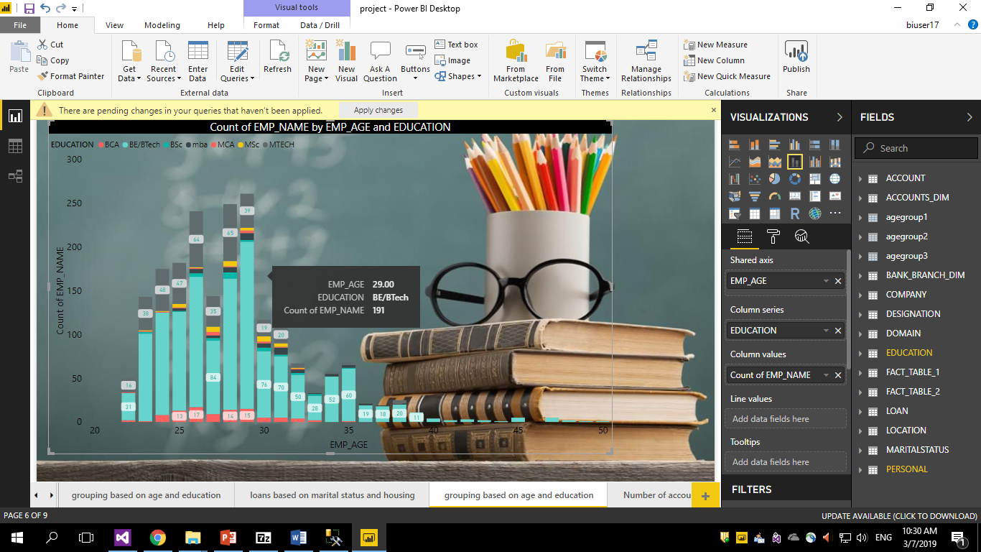
Count of employees by age and education

Slide 32
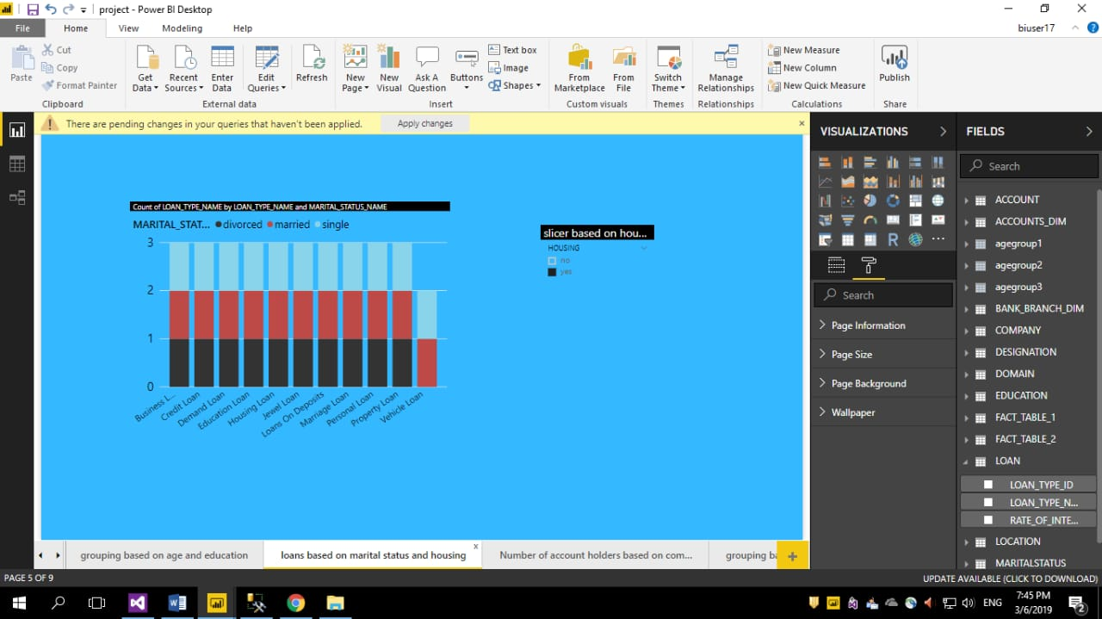
Loan analysis based on housing and marital status

Slide 33
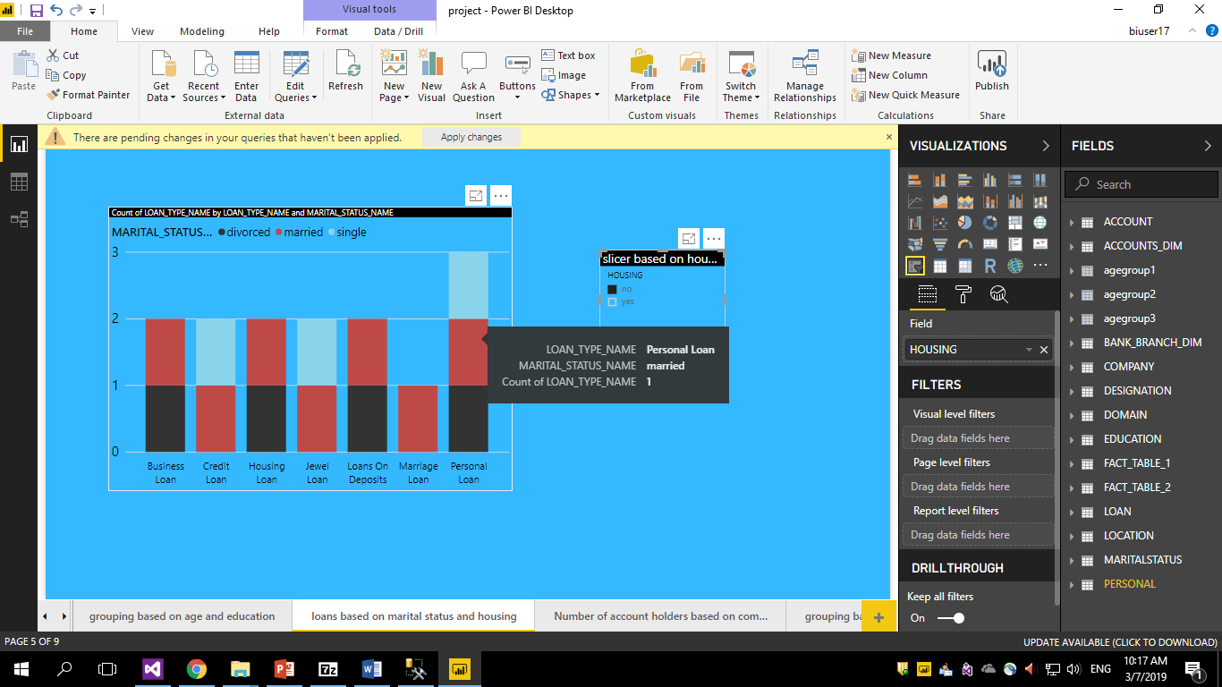
Loan analysis based on housing and marital status

Slide 34
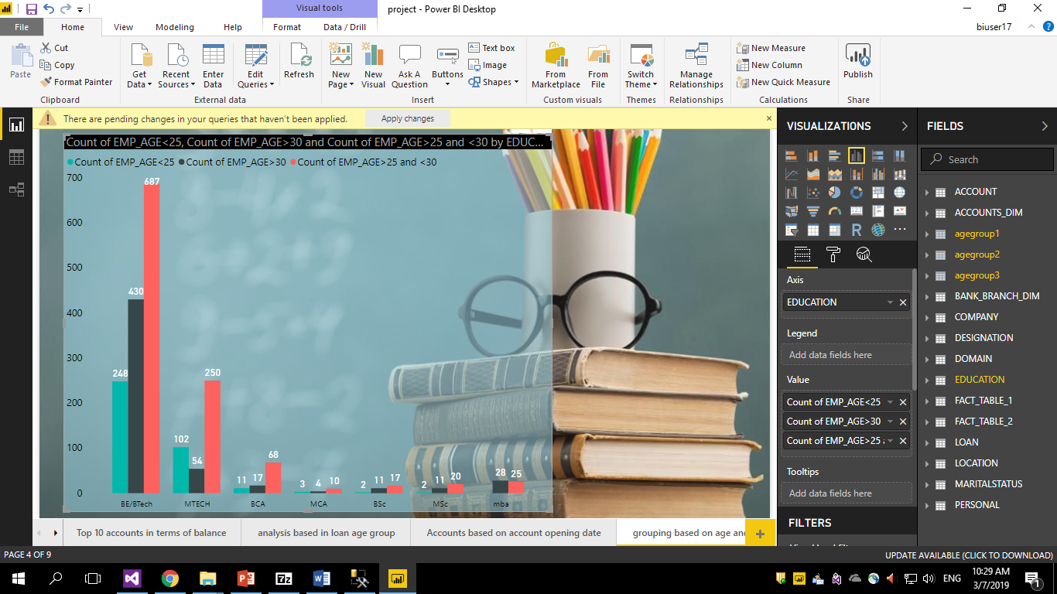
Count of employees by grouping age and education

Slide 35
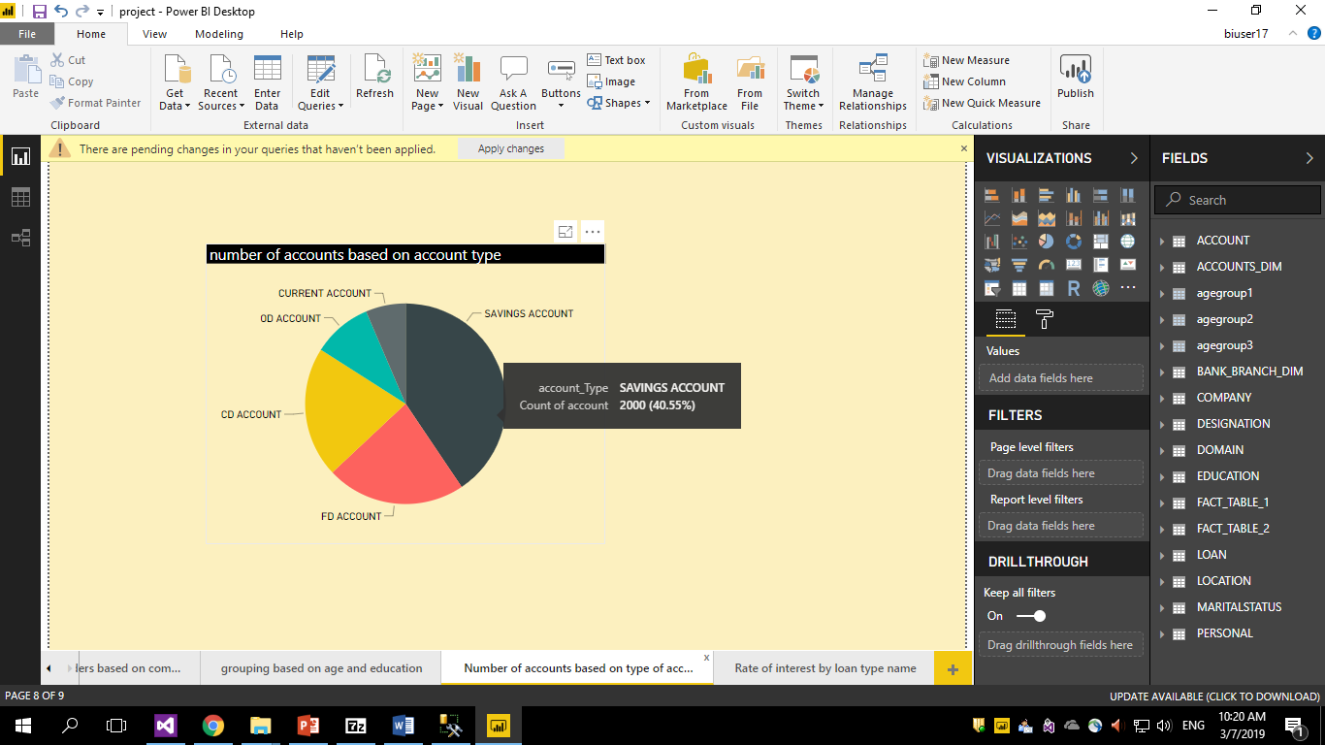
Analysis based on number of accounts by account type

Slide 36
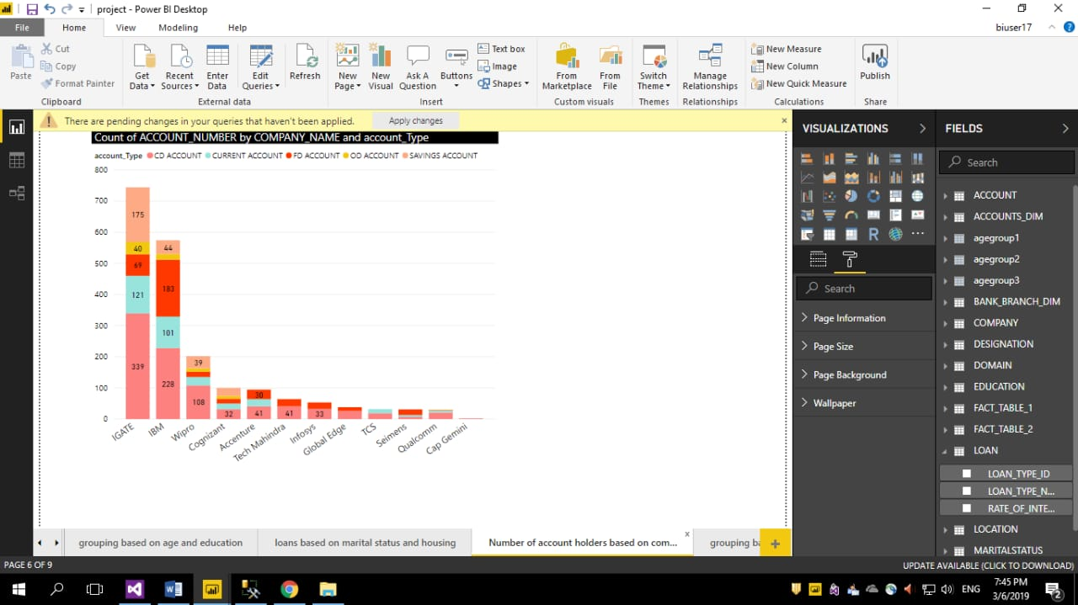
Number of accounts in each company based on account type

Slide 37
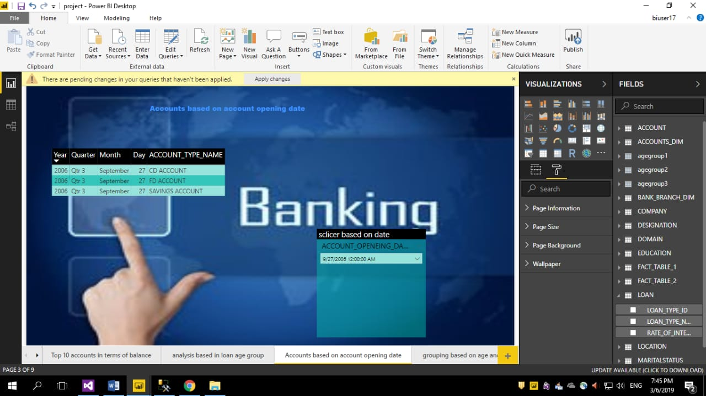
Accounts based on account opening date

Slide 38
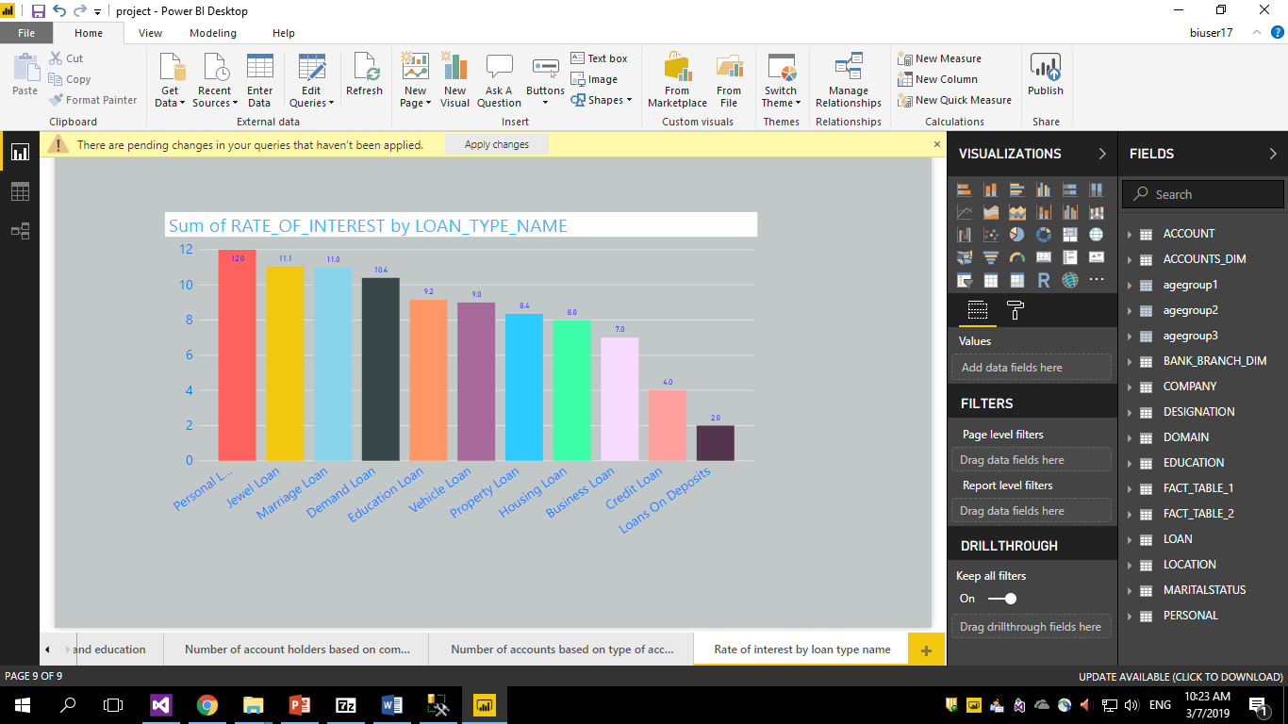
Rate of interest based on loan type name

Slide 39
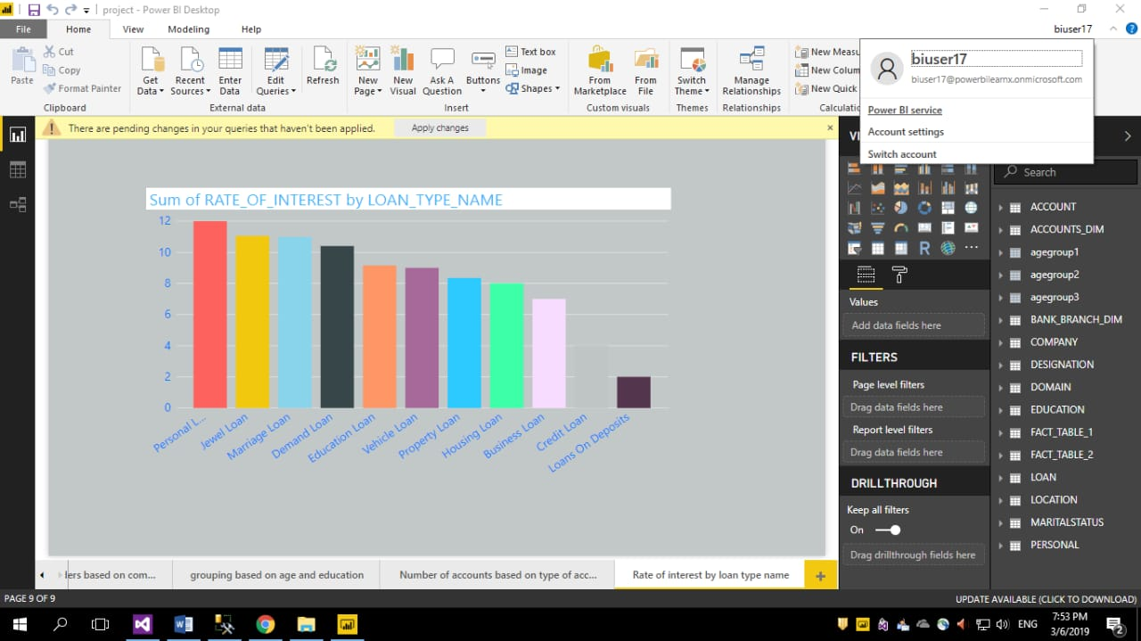
Publishing the reports to service

Slide 40
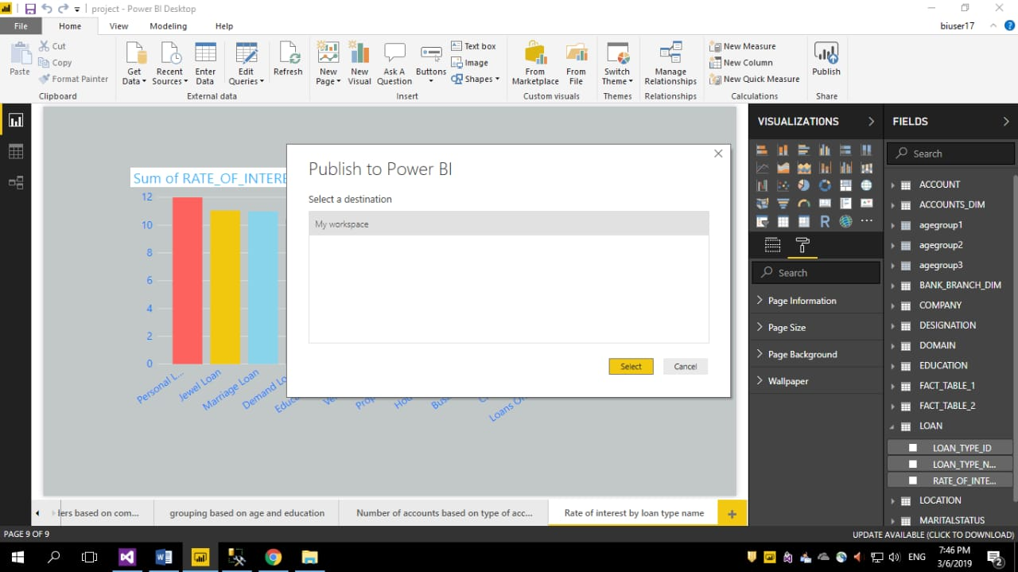
Selecting destination

Slide 41

Report published to service

Slide 42

Report in power bi service

Slide 43

Creating dashboard

Slide 44

Pinning the tile to dashboard

Slide 45


Slide 46

Dashboard

Slide 47


Slide 48
Thank you

